Slide 1

Weather App: A Web Development Project using HTML, CSS, and JavaScript
-Anchit Gupta
2018828

Slide 2

Introduction
Brief concept of a weather app and its importance in today's digital world
Mention the technologies used in developing the weather app, i.e., HTML, CSS, and JavaScript

Slide 3

Technology Used
technologies used in developing the weather app, i.e., HTML, CSS, and JavaScript
how each technology was used and its role in the project
example to illustrate the implementation

Slide 4
Features of the Weather App
key features of the weather app, such as real-time weather data retrieval, location-based weather information, user-friendly UI/UX, responsive design, etc
screenshots or visual representations of the app's features to make the presentation more engaging

Slide 5
Methodology/Planning of Work
methodology and planning used in developing the weather app
steps taken, including requirements gathering, design, development, testing, and deployment
challenges faced during the project and how they were overcome

Slide 6
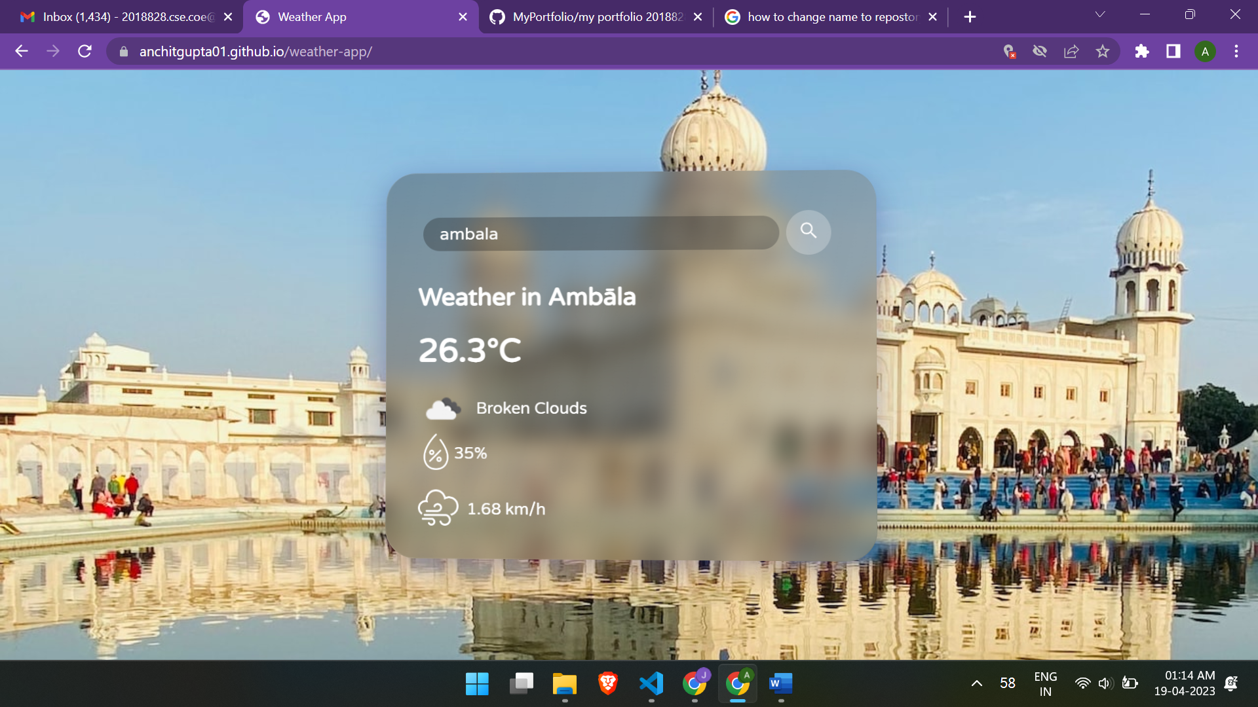

Slide 7
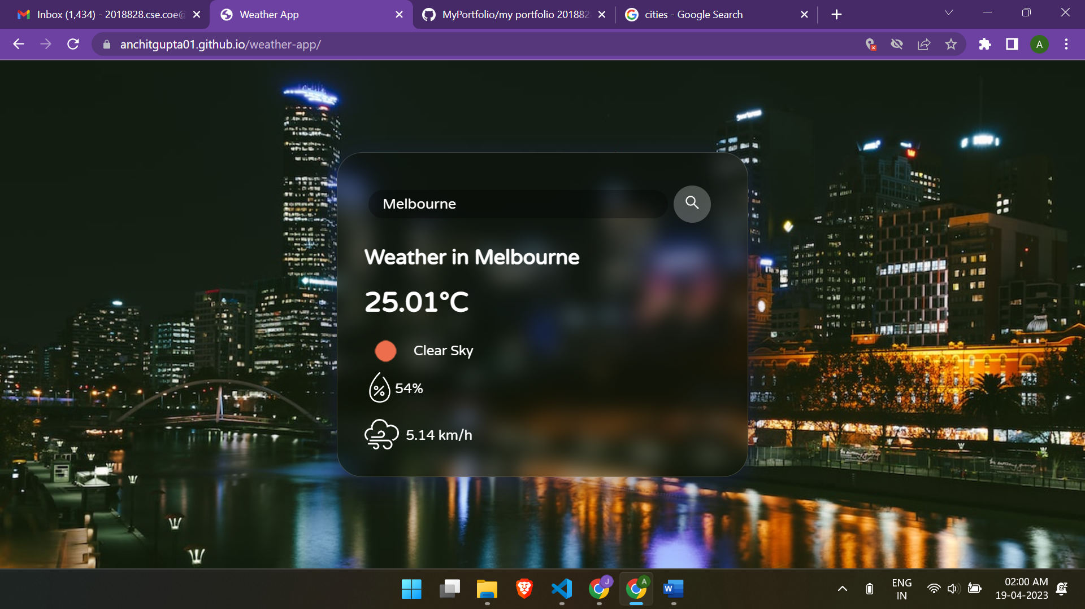

Slide 8
GitHub as Live Server
how GitHub was used as a live server for hosting the weather app
the setup process, including repository creation, branch selection, enabling GitHub Pages, and custom domain configuration
Highlight the benefits of using GitHub as a live server for hosting web applications

Slide 9
Conclusion
Summarize the main points covered in the presentation
potential future enhancements for the weather app, such as adding additional features, improving UI/UX, integrating with other APIs or services, etc
ongoing development and updates to the app

Slide 10

References
list of references, sources, and credits for any external resources used in the project, such as tutorials, libraries, APIs, etc
MDN Web Docs
"OpenWeatherMap API" - OpenWeatherMap. (https://openweathermap.org/api)
GitHub Pages
Visual Studio Code
Stack Overflow
https://anchitgupta01.github.io/weather-app/

